Slide 1
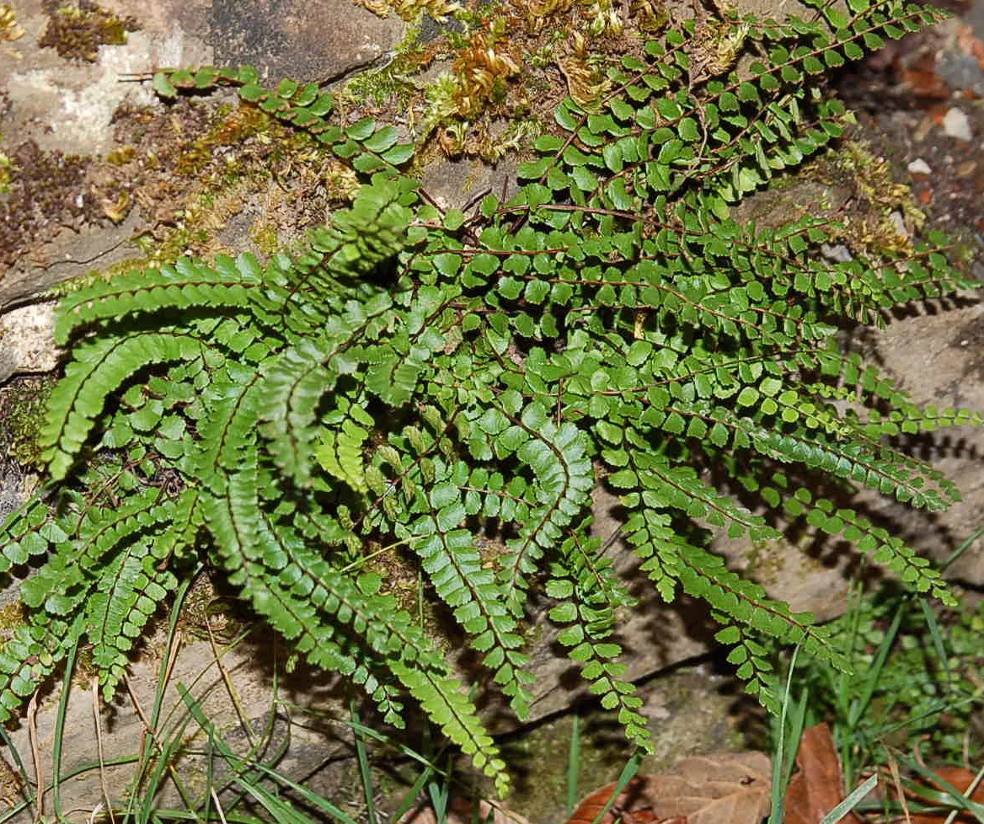
Classification of Birds
Background
The Ornithological Society is a diverse, global network of empowered professionals, working together to advance the scientific study and conservation of birds. The world’s largest international ornithological society, OS, is more relevant today than ever, and it is dedicated to supporting the scientists doing this critical work—for the sake of birds, humanity, and the planet.
Therefore, it wants to be able to bring ornithology closer to amateurs so they become interested in birds.
The Ornithological Society believes that this interest could bring about greater protection of wildlife in the country, as people would give more thought to wildlife conservation.
By Diana Muñoz
1

Slide 2
Classification of Birds
Problem
The society has an app that classifies birds according to their appearance and allows you to listen to birdsong, however, you cannot identify a bird by its sound, only by its image.
It wants to improve the app with a new option.
As a new option, the society wants to offer the public the opportunity to identify a bird. Amateurs can save birdsong and classify it using the app.
Interest
The Ornithological Society believes that this new feature can improve the use of the app.
Amateur ornithologists and other interested people can fully enjoy their hobby, identifying the bird by its song, its image and characteristics.
Completing the application with this function makes it more useful and interesting.
2

Slide 3
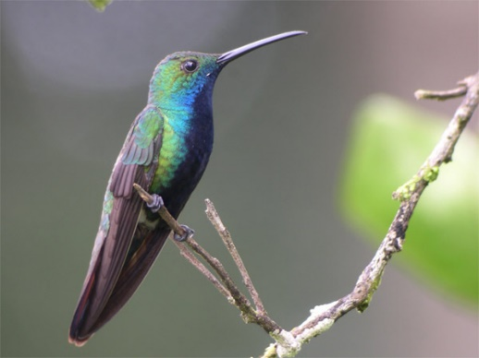
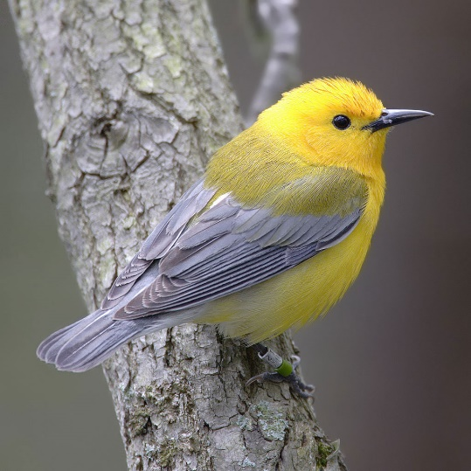
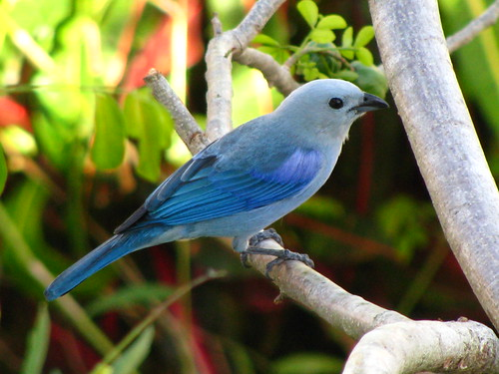
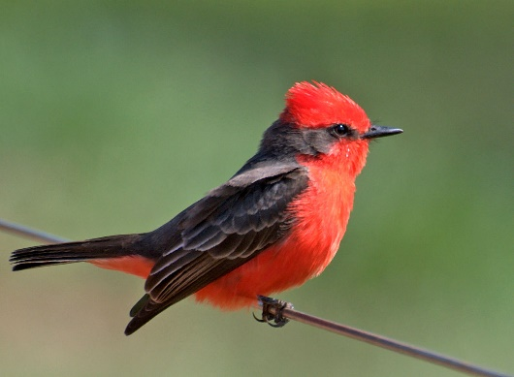
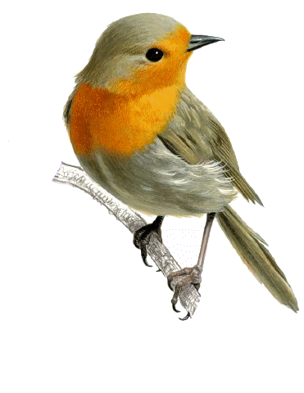
Classification of Birds
Data Sources
It was obtained from Kaggle.com:
Avian vocalizations (bird sounds) recorded in California and Nevada, USA:
This dataset contains a subset of recordings from California and Nevada, USA, including a balanced number of samples (30) per species. Recordings are labelled by species and also contain unstandardized labels for call type.
3

Slide 4

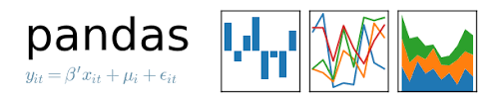











Classification of Birds
Tools and libraries
4

Slide 5
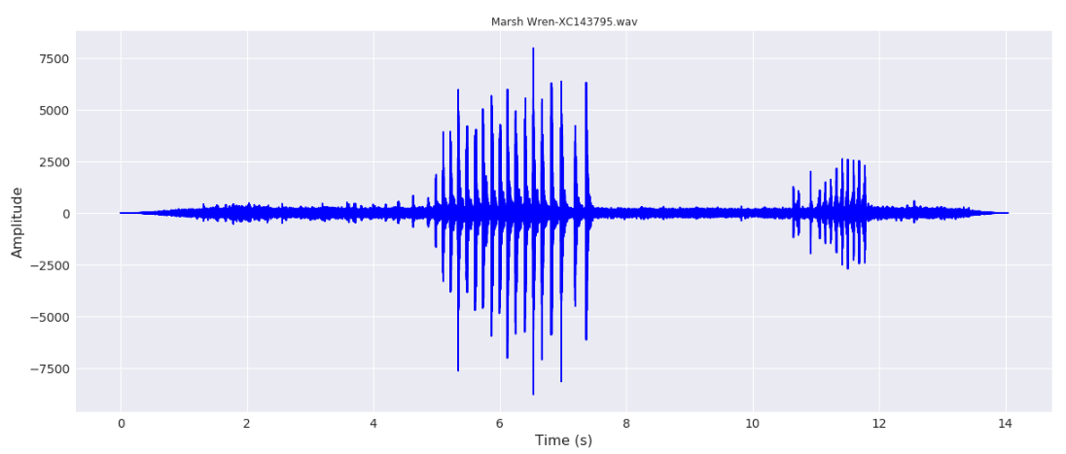
Classification of Birds
Data Cleaning
The mp3 files were extracted from zip files and converted to wav files to allow it to be read by python.
The sample rate (in samples/sec) and data was extracted from a wav file.
Normalized data was obtained by transforming the sampling rate of each file to 44100 and mono.
5

Slide 6
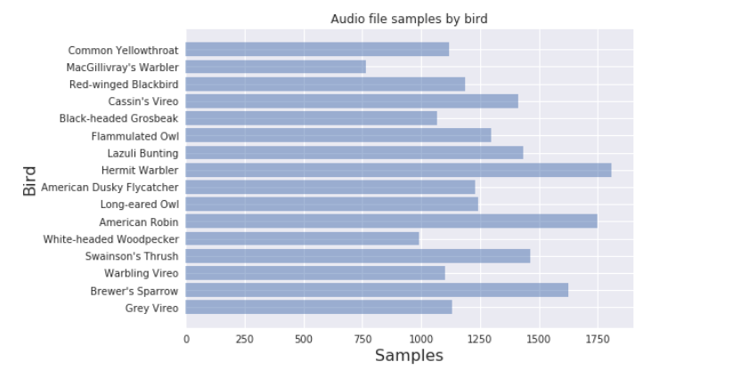
Classification of Birds
Since birdsong has a rhythmic pattern, the file has been divided into parts of a second to have more samples and, thus, prevent overfitting.
6

Slide 7
Classification of Birds
Once the data was normalized, Power Spectral Density (PSD) was estimated for each file using Welch’s method.
Welch’s method computes an estimate of the power spectral density by dividing the data into overlapping segments, computing a modified periodogram for each segment and averaging them. Welch's method is better than Fourier's transformation in terms of susceptibility to noise. Each bird species has a particular sound pattern that with the Welch method presents a characteristic curve with enough information and less sensitivity to noise.
7

Slide 8
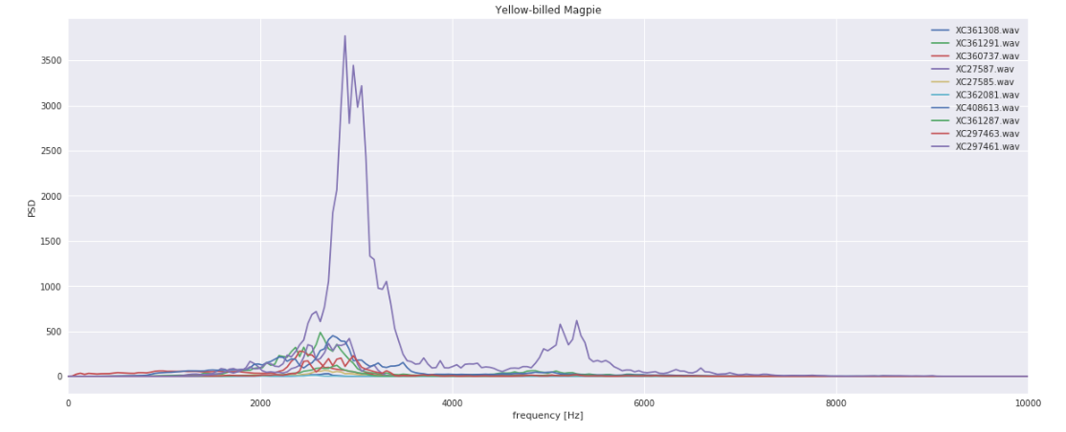
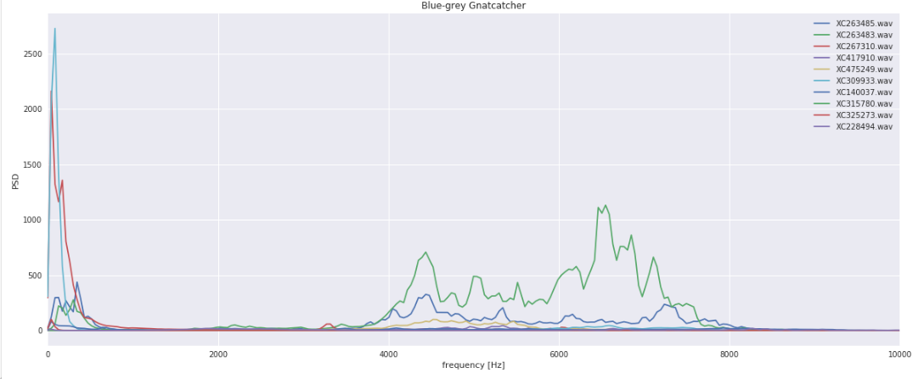
Classification of Birds
In this image, the power spectral density of 10 samples of sound files from a Yellow-billed Magpie and a Blue-grey Gnatcatcher were plotted so as to verify the similarity between them.
8

Slide 9
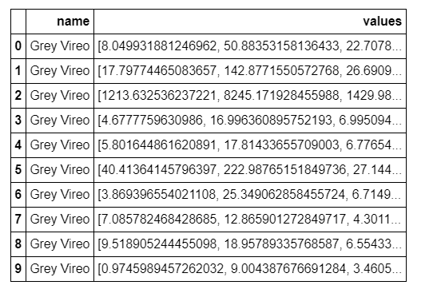
Classification of Birds
Feature Selection
Power spectral density values for each bird were stored.
9

Slide 10
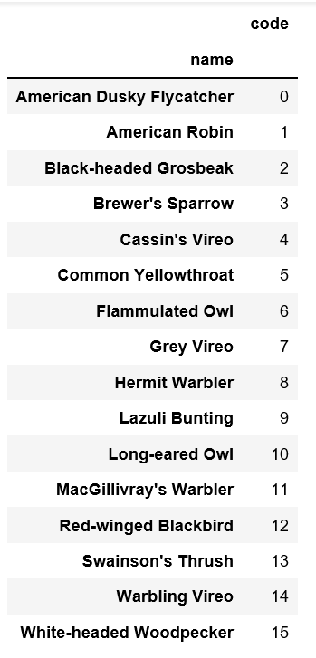
Classification of Birds
A code is assigned to each bird for classification:
10

Slide 11
Classification of Birds
Methodology
Since the use case is a classification with established targets, supervised classification algorithms were chosen such as:
Logistic regression
Convolutional Neural Network
11

Slide 12
Classification of Birds
Logistic regression
It’s one of the most popular supervised classification algorithm. This classification algorithm mostly used for solving binary classification problems but can also use to solve the multi-classification problems, as in this case of use.
The logistic regression algorithm has been tested for this use case, but the accuracy was not as expected, so it was decided to work with a neural network. Apache Spark has also been used.
Accuracy: | 0,1121673
False Positive Rate: | 0,1121673
True Positive Rate: | 0,1121673
F-measure: | 0,0226252
Precision: | 0,0125815
Recall: | 0,1121673
12

Slide 13
Classification of Birds
Convolutional Neural Network is a category of neural networks that have proven to be very effective in areas such as image recognition and classification, but it was used here for audio and the results are satisfactory.
Convolutional Neural Network 1D was chosen for this audio, since it has one channel.
In order to train the model, data was split into train data and test data, about 75% for train data and the remainder for test data.
85% accuracy was obtained when training the model.
It is shown that the convolutional neural network is a good model to train the use case, since a high percentage of accuracy is obtained.
13

Slide 14
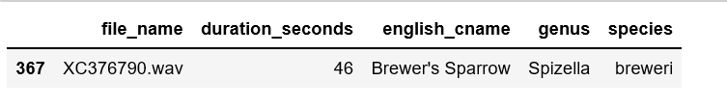
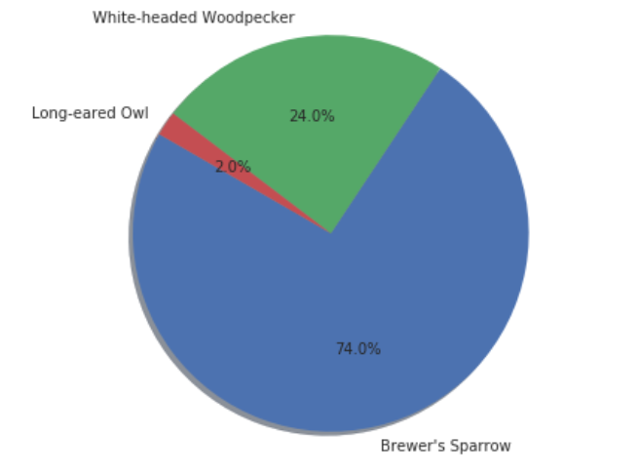
Classification of Birds
Check the model
It was checked with this file:
Result
The brewer's sparrow was classified with 74% accuracy. The next was a white-headed woodpecker with 24% and the last was long-eared owl. In this case, there is enough difference between the results, so it may not be useful to show all three of them.
14

Slide 15
Classification of Birds
Conclusion
The purpose in this use case was to classify a bird according its song.
The model shows good accuracy in the classification test, so it is believed that we can proceed to the next step to start developing the mobile app.
Since we obtain a percentage of the precision of the target, birds that are closer to the target should be displayed in descending order of precision, showing the percentage of each one, a photograph and an example of song that can be heard. Therefore the user can verify if the bird he/she is listening to is the one that has been shown in the highest position in the classification or the following ones.
15

